Slide 1
Talkify

Slide 2
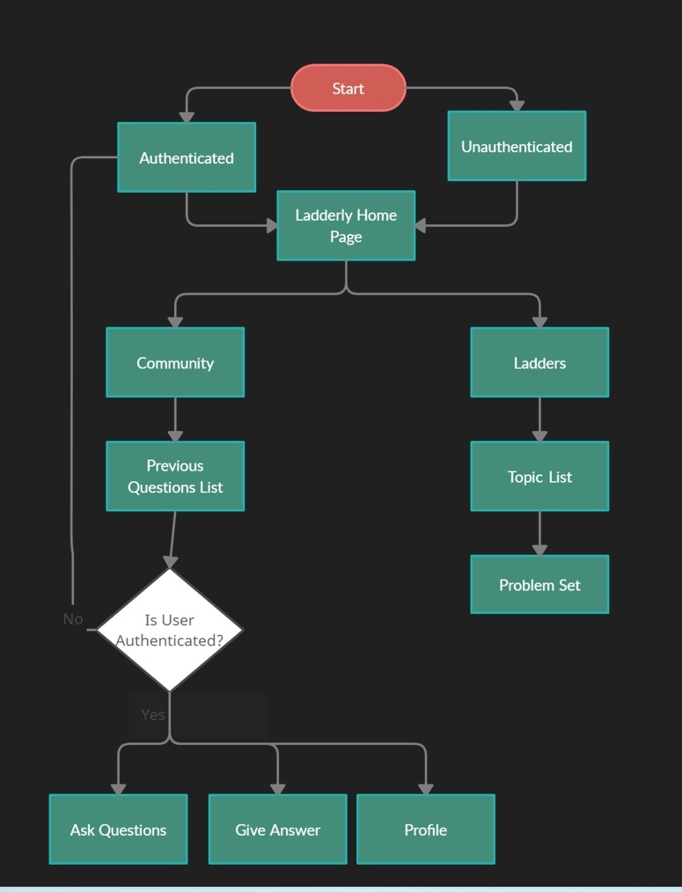
Work Flow

Slide 3
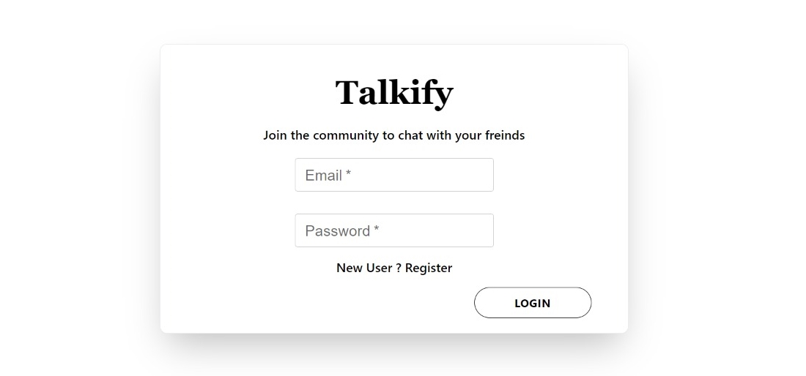
Sign in

Slide 4
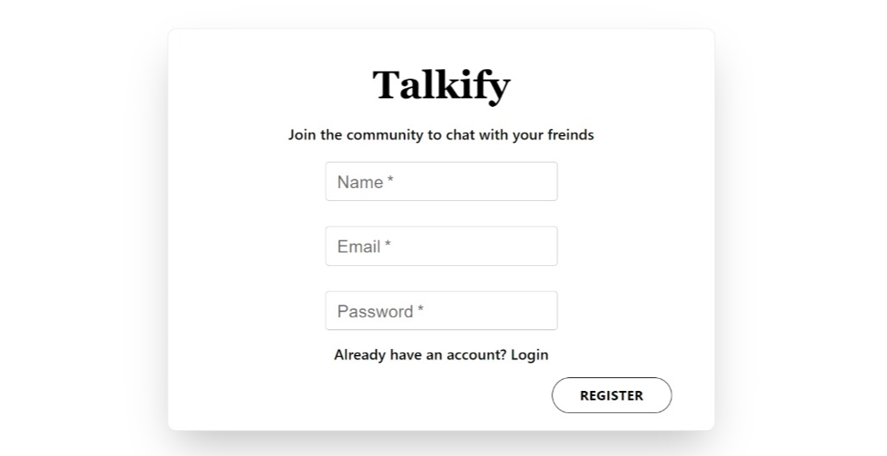
Sign Up

Slide 5
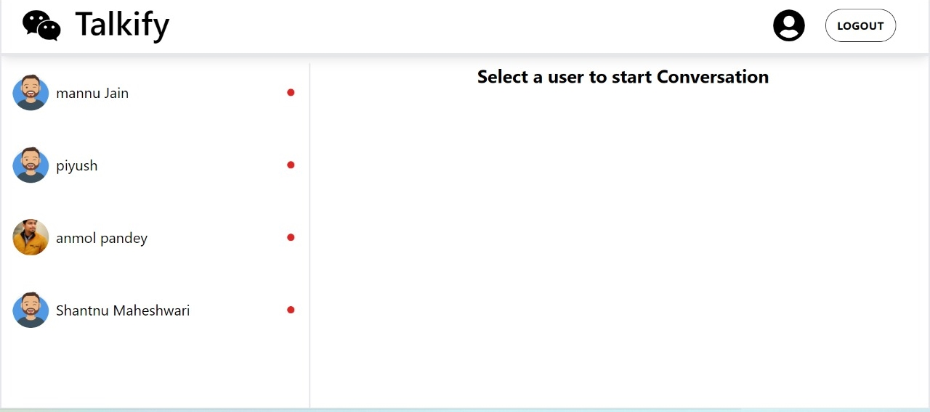
Home Page

Slide 6
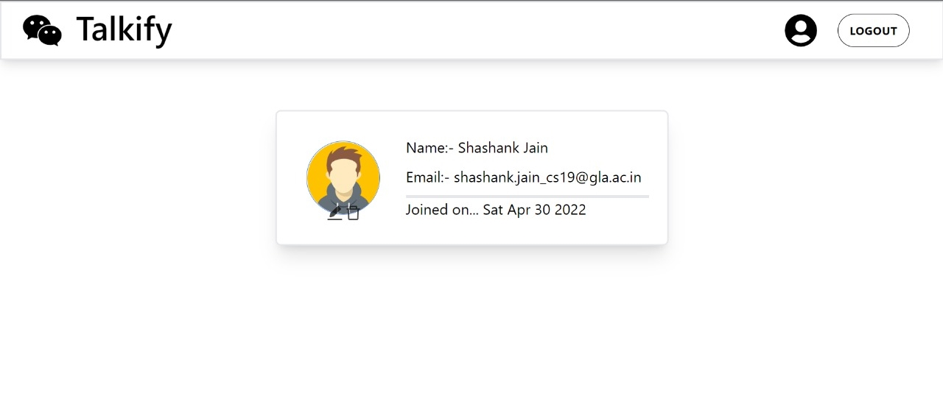
Profile

Slide 7
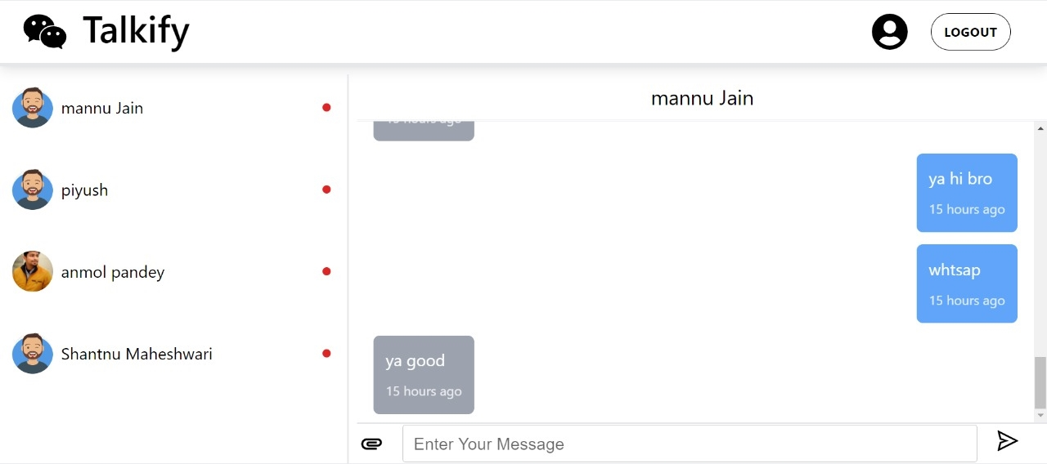
Chat Box

Slide 8
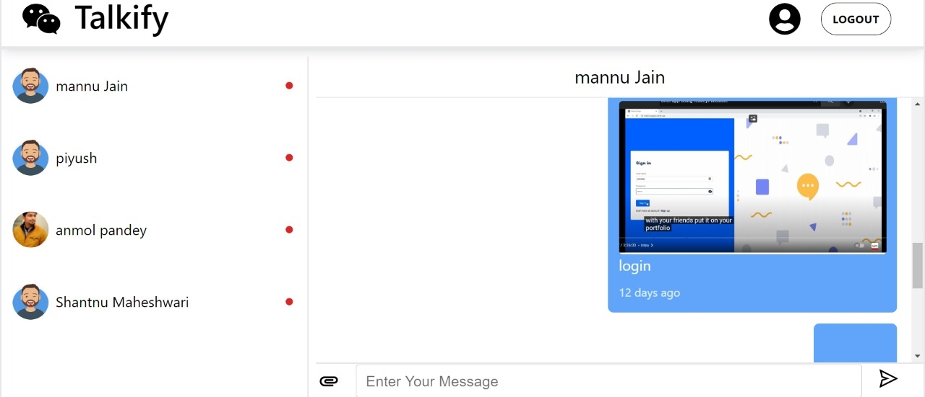
Image Sharing

Slide 9
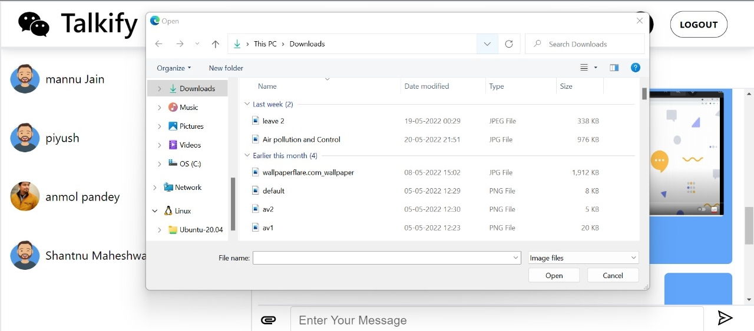
Image Sharing

Slide 10
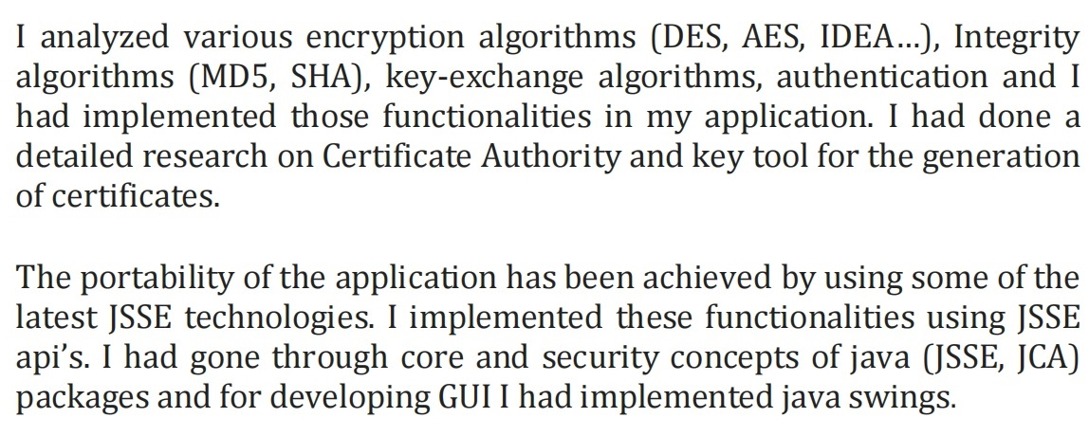
Future Scope

Slide 11
Members
Shashank Jain
Anmol Pandey
Piyush Sharma
Ankit
Shantnu Maheshwari

Slide 12
Thank you.

